Slide 1

K-12
The full journey
From one gift to one student, and everything the Foundation carries in between.
It starts with someone who already cares about your school
Parents
Teachers
Staff
Alumni
Neighbors
K-12 Scholarship Foundation, Inc.

Slide 2
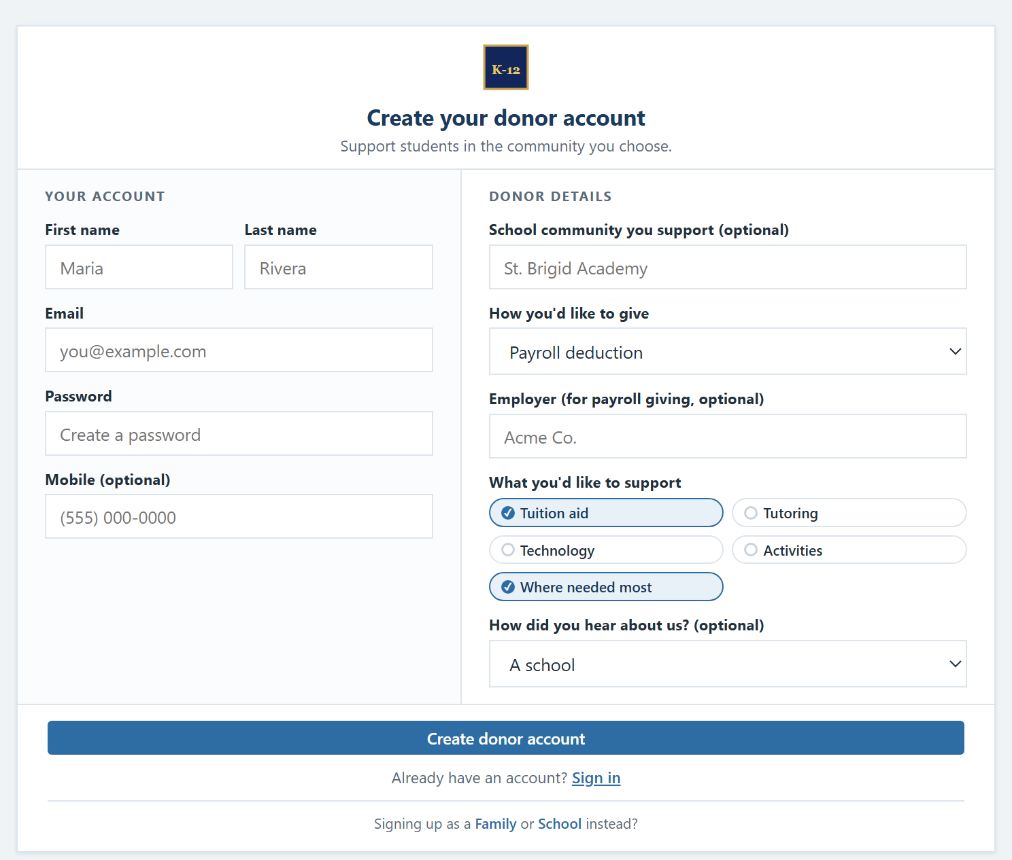
A gift begins with your community
They sign up in minutes, choose an amount, and choose the school community to support.
Sign up in minutes
Online, once. Nothing to mail, nothing to track.
Choose an amount up to $1,700
The annual cap on the federal credit.
Choose the school community
The Foundation makes every award under its own criteria.
Two ways to give: one-time or recurring, or right through payroll.
The donor sign-up screen
K-12 Scholarship Foundation, Inc.

Slide 3
Through payroll, take-home pay stays the same
Each payday, two small things happen at once, and they offset.
− $65
$65
$0
+
=
less federal tax withheld
to your scholarship gift
change to take-home pay
You adjust your own Form W-4. Neither the Foundation nor your employer changes it for you, and you can change it back at any time.
Illustrative: $1,700 ÷ 26 paychecks ≈ $65. The withholding drop and the gift offset, so net pay does not change.
K-12 Scholarship Foundation, Inc.

Slide 4

Every gift is received, recorded, and protected
The Foundation handles all of the federal compliance, so the school does not have to.
A dedicated scholarship account
At least 90% becomes scholarships
By law, every step of the way.
Every gift lands in a segregated scholarship account.
90% scholarships
10%
The Foundation issues an official receipt and donor record.
Administrative costs are capped at 10% by federal rule, so the vast majority of every dollar reaches students.
Personal information is safeguarded throughout.
All federal reporting and compliance is handled for you.
K-12 Scholarship Foundation, Inc.

Slide 5

Families apply. The Foundation awards.
Every scholarship is awarded under the Foundation's own federal criteria, never donor-directed.
Eligibility, verified
✓
Households with income up to 300% of area median (per federal limits).
Awarded by the Foundation
Donors express a preference for a school community. Awards are made on independent federal criteria, never directed to a particular student. Priority goes to renewing students and their siblings.
✓
Students eligible to attend a public school in the state.
✓
Verified once, then renewable in following years.
K-12 Scholarship Foundation, Inc.

Slide 6


And the funds reach your students
Every school type benefits, following the federal definition of qualified expenses.
Private & religious schools
Public & charter students
Tuition and fees, paid directly to the school, designed to cover up to the full cost depending on funds raised.
Tutoring, technology, books, transportation, and more, for the costs that help students learn.
K-12 Scholarship Foundation, Inc.

Slide 7
At tax time, the loop closes
The gift can be offset by the federal tax credit.
− $1,700
+
$1,700
=
$0
the gift to scholarships
less in federal taxes owed
net cost to the donor
No net cost, every single year you take part.
Credit is nonrefundable; you need at least $1,700 in federal tax liability to use it fully in one year; unused amounts carry forward up to five years.
K-12 Scholarship Foundation, Inc.

Slide 8


One simple loop
The community gives, your students benefit, and the Foundation carries everything in between.
Community
gives
Foundation
receives
Families
apply
Awards
made
Students
benefit
At least 90% becomes scholarships, the whole way through.
K-12 Scholarship Foundation, Inc.

Slide 9
K-12
The community gives.
Your students benefit.
Want the numbers for your own community? Try the calculator, or reach out anytime.
k12scholarshipfoundation.org
Federal tax credit available beginning January 1, 2027 in participating states, for donors with sufficient federal tax liability. The Foundation's SGO qualification is pending. This video is a simplified overview, not tax advice: please review your situation with your accountant or tax professional. Sources: irs.gov · ed.gov
K-12 Scholarship Foundation, Inc.

