Slide 1

K-12
The payroll option
Give through your paycheck. Your take-home pay stays the same, all year.
For anyone who earns a paycheck
K-12 Scholarship Foundation, Inc.

Slide 2
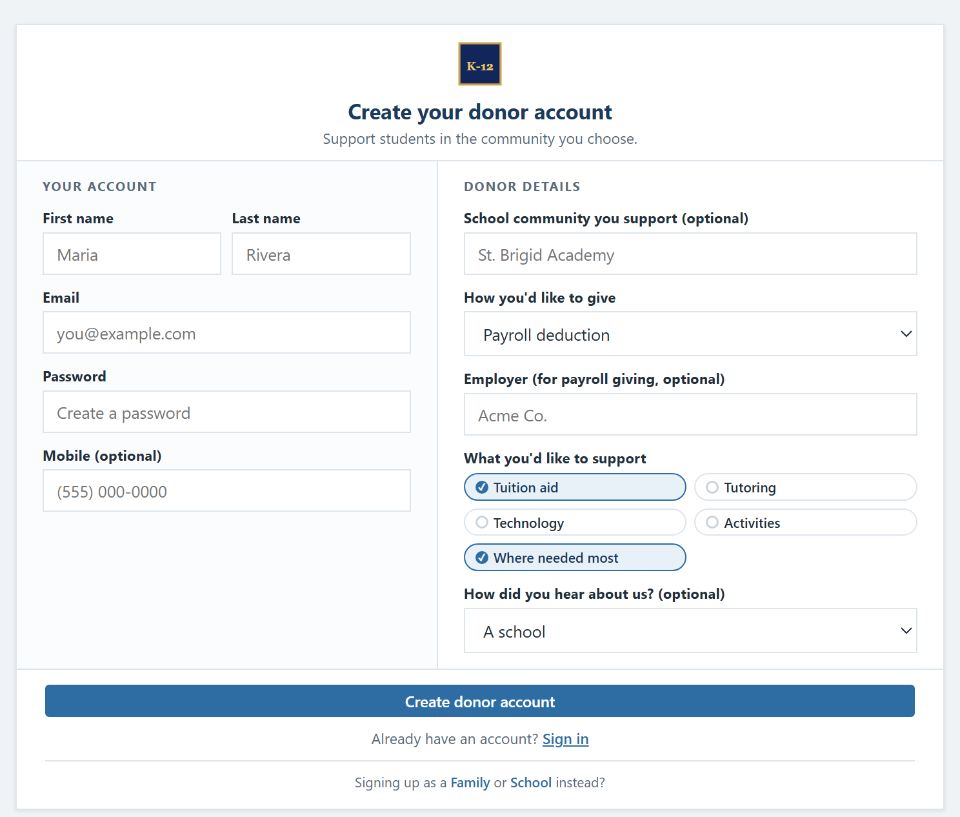
Step 1 · Sign up online
About five minutes, once. Nothing to mail, nothing to track.
Takes about 5 minutes
Sign up once, online. We confirm your details and generate the paperwork.
Any amount up to $1,700
Give up to the annual cap on the federal credit.
Choose the school you support
The Foundation makes every award under its own criteria.
The donor sign-up screen
K-12 Scholarship Foundation, Inc.

Slide 3

Step 2 · Adjust your own withholding
The credit lowers the tax you owe, so you can claim it now, through each paycheck.
You update your Form W-4
Always your choice
Because the federal credit reduces the tax you'll owe, you claim it now by adjusting your own Form W-4 with your employer. We provide pre-filled, step-by-step instructions, so it takes only a few minutes.
Withholding is always your own election. Neither the Foundation nor your employer changes it for you, and you can change it back at any time.
K-12 Scholarship Foundation, Inc.

Slide 4
Step 3 · Each payday, two things happen at once
A little less tax withheld, a little to your gift. They offset, so take-home stays the same.
BEFORE · A TYPICAL PAYCHECK
AFTER · WITH THE PROGRAM
Gross pay
$2,300
Gross pay
$2,300
Federal income tax
−$276
Federal income tax
−$211 (↓$65)
Scholarship gift
$0
Scholarship gift
−$65
Take-home pay
$1,600
Take-home pay
$1,600 ✓
Illustrative: $1,700 ÷ 26 paychecks ≈ $65. The withholding drop and the gift offset, so your net pay does not change.
K-12 Scholarship Foundation, Inc.

Slide 5


Step 4 · We handle the rest, you claim the credit
Your contributions are processed and documented. At tax time, it's one simple line.
The Foundation processes everything
At tax time, you claim the credit
Contributions go into a dedicated scholarship account. You receive an official acknowledgment, and at least 90% of all funds become scholarships, by law.
We send a simple year-end statement. Most filers just hand it to their preparer, or enter one number into their tax software.
K-12 Scholarship Foundation, Inc.

Slide 6
The year-end math
What it adds up to over a full year of participating.
$1,700
+
$1,700
=
$0
contributed to scholarships
federal tax credit claimed
change to your take-home pay
$1,700 in scholarships for your school community, every single year you take part.
Credit is nonrefundable; you need at least $1,700 in federal tax liability to use it fully in one year; unused amounts carry forward up to five years.
K-12 Scholarship Foundation, Inc.

Slide 7
K-12
No net cost. Real scholarships
for your students.
See what your own community could raise with the calculator.
k12scholarshipfoundation.org
Available beginning January 1, 2027 in participating states, for donors with sufficient federal tax liability. The Foundation's SGO qualification is pending. A simplified overview, not tax advice: please review your situation with your tax professional. Sources: irs.gov · ed.gov
K-12 Scholarship Foundation, Inc.

