Slide 1
K-12
K - 1 2 S C H O L A R S H I P F O U N D A T I O N
A new way your community
can fund your students
The federal scholarship tax credit · beginning January 1, 2027 · in participating states
Prepared June 2026 · Federal tax-exempt status application pending · A simplified overview, not tax advice: please review with your tax professional

Slide 2
The opportunity
Congress enacted a new federal tax credit for K-12 education.
Standing law, no sunset
Enacted July 2025 (P.L. 119-21). No expiration date; no national cap.
$1,700
Billions, nationwide
Will make billions of dollars available to support K-12 education.
per taxpayer, per year: a dollar-for-dollar federal tax credit for donations to approved K-12 scholarship organizations
Every school type
Public, charter, private, and religious school students can all benefit.
Begins Jan 1, 2027
27 states already elected to participate; more announcing.
K-12 Scholarship Foundation · Sources: irs.gov · ed.gov · treasury.gov
2

Slide 3





The catch
The funds can’t go to schools directly, and the process is complicated.
Donors
Schools
✕
want to give
can’t receive donations directly
Between a donor and a scholarship sit a lot of moving parts:
Finding donors &
sharing information
Eligibility &
income verification
Processing &
recordkeeping
Federal compliance
& the 90% rule
Awards &
payments to schools
K-12 Scholarship Foundation · Sources: irs.gov · ed.gov · treasury.gov
3

Slide 4



Where the Foundation fits
Created so your students benefit, without the administrative burden.
Your community gives
We handle everything
Your students benefit
Parents, teachers, staff, alumni, and neighbors. The support doesn’t come from somewhere new. It comes from the people already around your school.
Materials and answers for your community, processing, eligibility, and federal compliance. By law, at least 90% of funds become scholarships.
Tuition support at private schools, plus tutoring, technology, class trips, and equipment for public and charter school students.
A built-in donor base
Zero burden on schools
At no cost to your school
K-12 Scholarship Foundation · Sources: irs.gov · ed.gov · treasury.gov
4

Slide 5
Every school already has a community
The people with a stake in your students’ success are the scholarship fund.
Parents &
guardians
Teachers
YOUR
SCHOOL
Staff &
administrators
Alumni
Board &
boosters
Neighbors &
local businesses
Each can give up to $1,700/year, and get it all back as a federal tax credit
K-12 Scholarship Foundation · Sources: irs.gov · ed.gov · treasury.gov
5

Slide 6
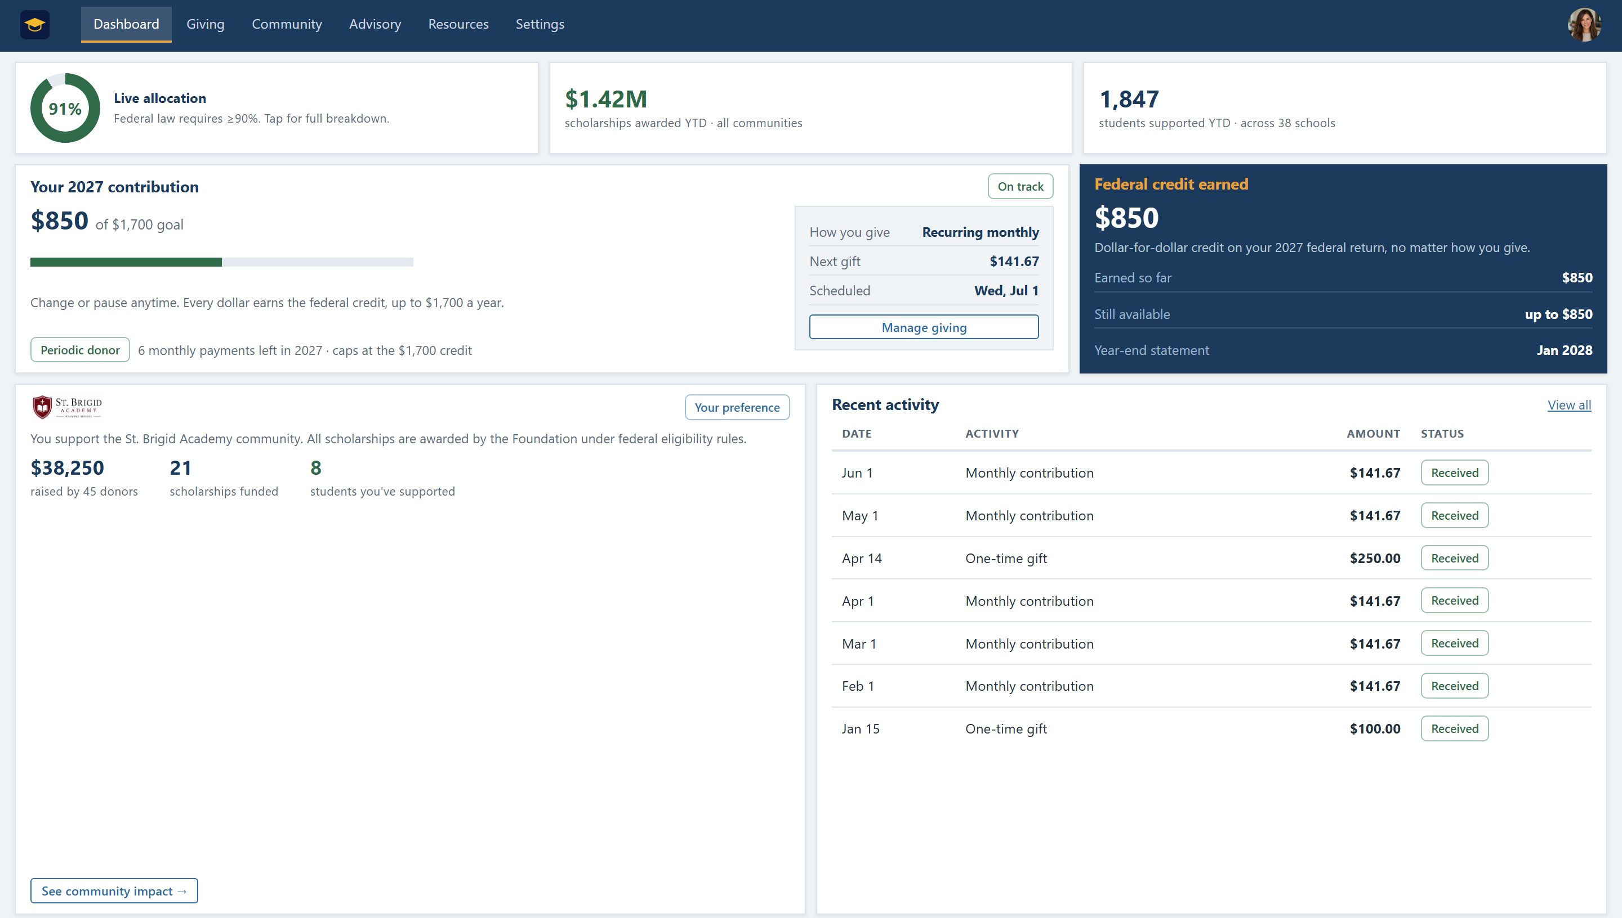
How it works
Four moving parts, all handled for you.
1
We share the information
Ready-to-share materials that answer your community’s questions.
2
Your community contributes
Supporters sign up online and choose the school they support.
3
A simple system tracks it all
Easy to track, with full transparency: receipts, statements, live reporting.
4
Scholarships reach your students
The Foundation awards under federal rules; at least 90% becomes scholarships.
The live giving dashboard: every gift tracked, with full transparency
K-12 Scholarship Foundation · Sources: irs.gov · ed.gov · treasury.gov
6

Slide 7
No net cost to donors
Each contribution can be offset by the federal tax credit.
−$1,700
+$1,700
$0
+
=
donated to scholarships
for your school community
federal tax credit:
taxes owed go down dollar-for-dollar
net cost to the donor,
every single year
For employees, it’s even simpler: a small payroll contribution (about $65 per biweekly paycheck) pairs with a matching withholding adjustment, so take-home pay stays the same all year.
Credit is nonrefundable; donors need at least $1,700 in federal tax liability to use it fully in one year; unused amounts carry forward up to 5 years. Simplified overview, not tax advice: please review your situation with your accountant or tax professional (irs.gov).
K-12 Scholarship Foundation · Sources: irs.gov · ed.gov · treasury.gov
7

Slide 8
Beyond tuition
Scholarships follow the federal expense definition. Every school type benefits.
PRIVATE & RELIGIOUS SCHOOL STUDENTS
Tuition and fees: scholarships designed to cover up to the full cost, depending on funds raised, paid directly to the school.
Who qualifies? Most families.
✓
Household income up to 300% of the area median; the large majority of families
✓
Student eligible to enroll in public K-12 school (current school doesn’t matter)
PUBLIC & CHARTER SCHOOL STUDENTS
Tutoring · technology · books & supplies · transportation · special-needs services · class trips · equipment, as confirmed by the joint U.S. Education & Treasury fact sheet.
✓
Scholarship money is not taxable income to the family
✓
Renewing students and siblings get priority by federal law
K-12 Scholarship Foundation · Sources: irs.gov · ed.gov · treasury.gov
8

Slide 9
What could your community raise?
A simple, conservative example: 10% participation.
400
≈ 220
+ 50
= 270
students
parent households
teachers & staff
potential donors
If just 10% participate (27 donors × $1,700):
$45,900 per year
at 25% participation: $114,750 / year · over five years at 10%: $229,500
Estimates assume $1,700 per participating donor and ~1.8 children per family; actual results depend on participation and eligibility.
K-12 Scholarship Foundation · Sources: irs.gov · ed.gov · treasury.gov
9

Slide 10
Built for trust
The questions every administrator asks, answered up front.
Is this legitimate?
Where does the money go?
It’s federal law: Section 70411 of P.L. 119-21, codified at 26 U.S.C. §25F. The IRS, Treasury, and Dept. of Education all publish program guidance, and we cite them on everything.
Federal law requires at least 90% of funds to become scholarships. Administration is capped at 10%, and we’ll publish our numbers.
Can donors pick students?
Is this political?
No. Federal law prohibits it. Donors may express a preference for a school community; the Foundation makes every award under its eligibility criteria.
We’re strictly nonpartisan. The program is law; our mission is making sure every kind of school (public, charter, private) can use it.
What does our school do?
What’s your status?
Almost nothing. Share the materials we provide; we handle processing, verification, compliance, and reporting end-to-end.
Honestly stated: our 501(c)(3) application is pending, and state SGO listings open later this year. Groundwork now means benefits on day one.
K-12 Scholarship Foundation · Sources: irs.gov · ed.gov · treasury.gov
10

Slide 11
The road to January 2027
Why the groundwork happens now.
July 2025
~Sept 2026
Jan 1, 2027
Credit enacted into federal law
Federal regulations expected
Credit goes live · donations qualify
Jan–June 2026
Q4 2026
27 states elect in; NY announces intent
States certify their SGO lists
Schools that wait until 2027 lose a year. The communities laying groundwork now (materials shared, supporters informed, sign-ups ready) are the ones whose students benefit from day one.
K-12 Scholarship Foundation · Sources: irs.gov · ed.gov · treasury.gov
11

Slide 12
The full journey: from a gift to a scholarship
Every moving part between a donor and a student, all carried by the Foundation.
Your community gives
The Foundation receives
Families apply, verified
The Foundation awards
Your students benefit
Sign up online, choose an amount up to $1,700, and choose the school community to support. One-time, recurring, or through payroll.
Every gift lands in a dedicated scholarship account: receipt issued, information safeguarded, federal compliance handled.
Families apply once. The Foundation checks eligibility: income up to 300% of the area median, public-school-eligible.
Awarded under the Foundation's own federal criteria, priority for renewing students and siblings. Donors never pick a student.
Tuition at private & religious schools; tutoring, technology, transport, trips, and equipment at public & charter schools.
−$1,700
+
$1,700
=
$0
≥ 90% becomes scholarships
the gift
less in taxes owed
net cost
Admin capped at 10% by federal law, covered before funds reach your school.
K-12 Scholarship Foundation · Sources: irs.gov · ed.gov · treasury.gov
12

Slide 13
K-12
Let’s get your community ready.
A 20-minute conversation is all it takes to see what this could mean for your school.
1
2
3
Schedule a time to learn more
We map your community’s potential
Your school is ready for day one
k12scholarshipfoundation.org · Schedule a time to learn more
The K-12 Scholarship Foundation, Inc. · Federal tax-exempt status application pending; SGO listing occurs through participating states.
Program begins January 1, 2027. This overview simplifies the program and is not tax advice; please review your plans with your accountant or tax professional and the sources here. Sources: irs.gov · ed.gov · treasury.gov

